Slide 1


COVID: Phase 2 Human Trial Results
United Kingdom – completed phase IIb – primary efficacy endpoint achieved
Double blinded early treatment for people tested COVID positive, 79 subjects (39 treatment, 40 placebo)
Regimen: self-administration of NONS 5-6x/day
Results:
  significant reduction in viral load in the treatment arm, compared to control arm, from Day 1 through 6
  treatment arm showed 16x higher viral reduction than saline placebo arm on days 2 and 4 and 11 times on day 6
  no adverse events from ~2000 doses
1

Slide 2
COVID 19- Human Clinical Trial in UK
Randomized, double blinded, Placebo controlled Clinical Efficacy Study Evaluating SaNOtize’s nasal spray for Early Treatment of COVID-19
Product: NONS (nitric oxide nasal spray)
Regimen: daily self-administration of Nasal Spray 5 times per day. Treatment arm – NONS, control – saline nasal spray. Ratio – 1:1
Up to date : 79/110 subjects were enrolled and completed the trial. Interim analysis show significant reduction in viral load in the treatment arm, compared to control arm, on Day 2 and Day 4.
No adverse events have occurred.
Study voluntarily stopped once Primary End Point was statistically achieved
To date, one hundred and forty two(142) subjects have administered over 9,000 nasal spray treatments with no side effects at all

Slide 3
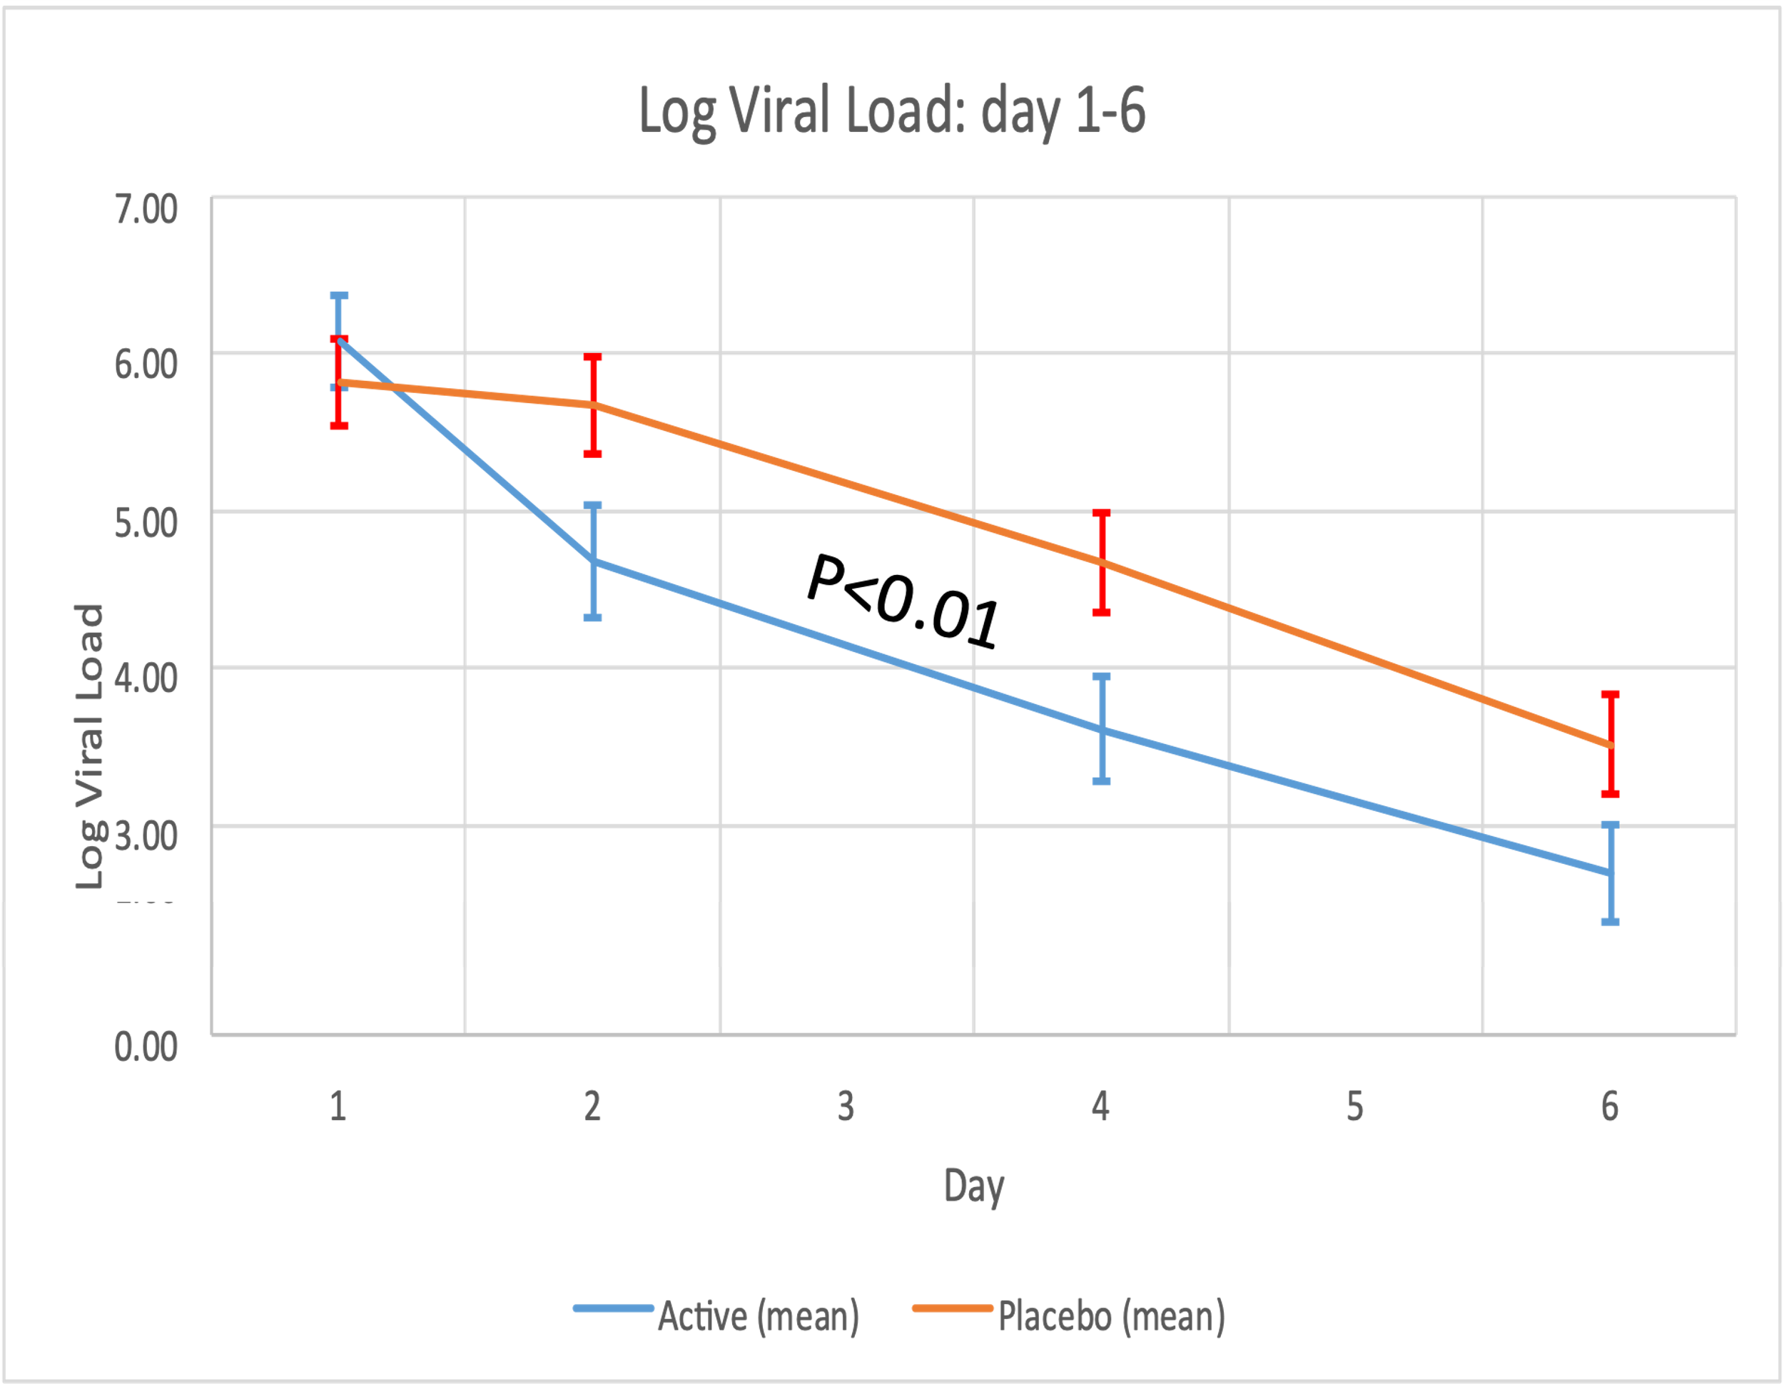
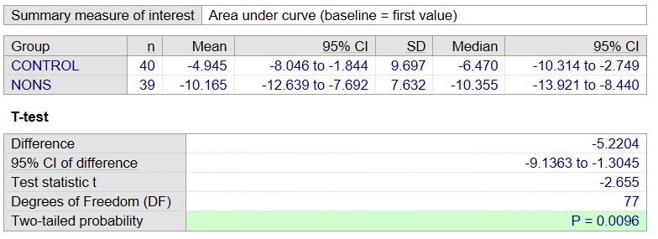
UK Human Trial – Primary End Point Achieved
Reduction in viral load reveals a mean difference of -5.22 log10 copies/ml on NONS, compared to saline control, from day 1 through to day 6 (p=0.0096).
Average SARS-CoV-2 concentration was lower on NONS, as compared to placebo, by a factor of 16 at both days 2 and 4.
No adverse events were recorded in the NONS group.
The majority of patients in this study were positive for SARS- CoV-2 UK variants
Primary End Point: Viral reduction Day 1 through Day 6 (Area under curve)

Slide 4
 | Mean log reduction day 1 to day 2 | Mean log reduction day 1 to day 4 | Mean log reduction through to day 6
Control | 0.154 | 1.186 | 4.945
Treatment | 1.362 | 2.4 | 10.165
P Value | 0.0065 | 0.0157 | 0.0096

Slide 5
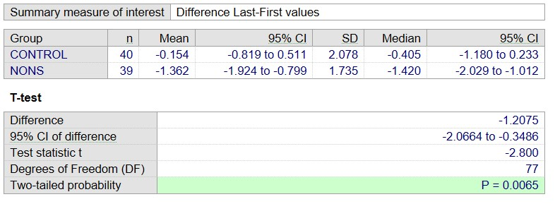
Changes from Day 1 to 2 – 16 times higher reduction in Tx compared to control

Slide 6
UK phase II trial results - First 24 hours on treatment/control
Log₁₀ viral load
Log₁₀ viral load
Day
Day
Log₁₀ viral load on day 1 and day 2 in nitric oxide nasal spray treatment group and control (saline) group. Red – represents increasing viral load, blue represents decreasing viral load

Slide 7
viral load
Day

Slide 8
viral load
Day

Slide 10
symptoms
. Forty subjects provided summary information, 15 on NONS and 25 on Placebo. Of these, 4/15 (26.7%) on NONS and 9/25 (36%) on placebo reported ‘worsening' symptoms, BUT 3 of these 4 (with complete data) on NONS were only worse on Day 1-2, and then were ‘better’ on treatment, while those on placebo seemed to continue to get worse on treatment with the 2 placebo subjects that did improve, it wasn’t until after Day 5 on treatment. However, 1 NONS subject reported worsening symptoms (Day 11) after being off treatment, 1 placebo subject required hospitalization for COVID-19 management at Day 7, and 1 placebo subject's symptoms remained and when re-tested was + for COVID-19, 2 days after being out of isolation. Interestingly, 7/15 (46.7%) NONS and 2/25 (8%) Placebo reported getting ‘better’ on treatment, typically by Day 2-4 on NONS treatment.

